Slide 1
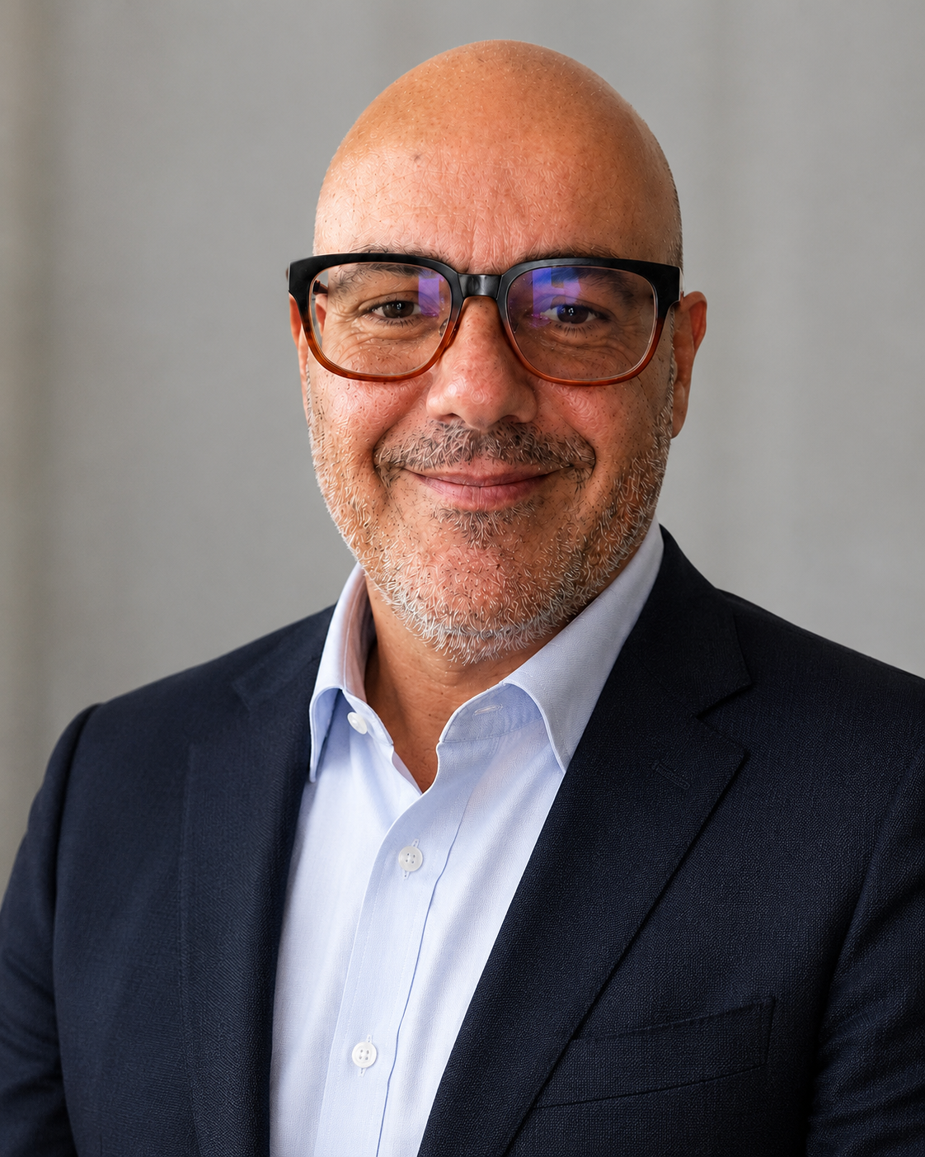
RDF
PROFESSIONAL PORTFOLIO
Dr. Rocco
de Filippis
MD, PhD, MSc
Psychiatrist & Neuroscientist
Mood disorders, forensic psychiatry
and clinical AI research
Clinical practice since 2005
01
Notes:
Credentials and professional identity as supplied and reported on the portfolio. Clinical practice since 2005 supported by institutional CV. Sources: https://secure-portfolio-hub.emergent.host/
https://www.istitutodipsicopatologia.it/wp-content/uploads/2023/01/Cv-Rocco-de-Filippis-Istituto-di-Psicopatologia.pdf
Portrait: https://customer-assets-wrfwihn1.emergentagent.net/job_secure-portfolio-hub/artifacts/uocn6lfk_Email_Photo.png

Slide 2
Research record and manuscript pipeline
154
46
CV bibliography entries
Manuscripts reported
11
35
Accepted, not yet published
Under review
CV bibliography includes articles, conference contributions and chapters.
Cross-listed records have not been combined into a unique published-paper total.
Sources: supplied CV and user update, 4 November 2026
02
Notes:
Source: CV_Rocco_ENG_Jan_2025(1).pdf, supplied 4 November 2026 and internally dated 3 October 2026. The main bibliography is numbered 1–154 and includes posters, chapters and an in-press entry. At least eight of the ten accepted-section titles also appear in the main bibliography. The PDF has ten accepted titles and 33 under-review titles; the user updated aggregate counts to 11 accepted but not yet published and 35 under review, totalling 46 manuscripts. One accepted title and two under-review titles are not yet supplied. Do not interpret 154 as unique published journal articles or add 154 and 46 without reconciliation. Historical original-portfolio figure of 4,549+ citations remains unreconciled and is not a verified current bibliometric total.

Slide 3
Clinical and forensic expertise
Mood
disorders
Forensic
psychiatry
Teaching and
clinical research
Treatment-resistant depression
and bipolar disorder
Civil and criminal
psychiatric consultancy
Forensic psychopathology
and psychiatric education
2005
Clinical practice
2012
Forensic consultancy
2016
University teaching
CV: psychiatrist at Centre Hospitalier du Gers since September 2026
Source: supplied CV and institutional professional record
03
Notes:
The supplied CV reports a psychiatrist role at Centre Hospitalier du Gers since September 2026. This is a CV-reported role, not independently reconfirmed. The institutional CV states clinical practice began in 2005, forensic consultancy since 2012, and teaching forensic psychopathology at the Catholic University of the Sacred Heart since 2016. These describe the CV record and do not constitute renewed verification of current appointments. It identifies expertise in treatment-resistant depression and bipolar disorders. Source: https://www.istitutodipsicopatologia.it/wp-content/uploads/2023/01/Cv-Rocco-de-Filippis-Istituto-di-Psicopatologia.pdf

Slide 4
Research contributions
Psychiatric treatment
Reviews and evidence synthesis
Acta Psychiatrica Scandinavica · World Journal of Psychiatry
Addiction care
Clinical trial contributions
Addiction · Journal of Psychopharmacology
AI and mental health
Prediction, explainability and governance
Discover Artificial Intelligence · Italian Journal of Psychiatry
Selected publication venues · sources in speaker notes
04
Notes:
Selected journals publishing work attributed to Rocco de Filippis in the supplied CV and matched article records. Venue names describe publication history; no journal ranking or endorsement is implied. Mood-disorder reviews: World Journal of Psychiatry, https://www.wjgnet.com/2220-3206/full/v5/i3/330.htm ; Acta Psychiatrica Scandinavica, https://doi.org/10.1111/acps.13055 . Addiction and Journal of Psychopharmacology: trials listed in CV entries 7 and 10. Mental-health analytics: https://link.springer.com/article/10.1007/s44163-024-00169-6 . AI governance review: https://www.italianjournalofpsychiatry.it/article/view/543 .

Slide 5
Selected Google Scholar citations
139
105
36–37
Treatment-resistant
depression review
Pramipexole review
and meta-analysis
Student stress and
machine learning
40
Real-world pramipexole review
123
Alcohol withdrawal trial
119
Alcohol dependence trial
Stress paper: 36 in profile detail, 37 in search for the same Scholar cluster.
Counts across platforms or duplicate article records are not added together.
Article-level evidence checked directly on 4 November 2026
05
Notes:
Google Scholar records read directly on the authorized computer on 4 November 2026. Search: https://scholar.google.com/scholar?hl=en&q=%22Rocco+de+Filippis%22 . Selected records: Pharmacologic approaches to treatment resistant depression (2015): 139, cluster 16831618984242912766; Pramipexole in the treatment of unipolar and bipolar depression, Acta Psychiatrica Scandinavica (2019): 105, cluster 15045476110304454609; student stress (2024): 37 in search, cluster 5847105774365037686; 36 on article profile detail https://scholar.google.com/citations?view_op=view_citation&hl=en&user=cQ_zolQAAAAJ&citation_for_view=cQ_zolQAAAAJ:Se3iqnhoufwC . A separate duplicate stress-paper record with 7 citations was observed but not added. The co-author profile total of 153 is Abdullah Al Foysal's, not Rocco's, and is not attributed to Rocco. Life real-world review (2023): 40, cluster 16820473914951553317; alcohol withdrawal trial (2010): 123, cluster 13591158276080587151; pregabalin versus naltrexone trial (2010): 119, cluster 1192308573639467313. All figures are paper-level snapshots, not a sum or independent ranking. Publisher/index comparison: TRD review publisher 86, Acta Wiley/Crossref 72, Life Crossref 24, stress Crossref 25. Platforms have different coverage. No dedicated Rocco author-profile career total or h-index verified. Citation counts do not certify study quality. Full evidence and DOI metadata are in website source records.

Slide 6
Current direction
AI in psychiatry
Prediction and explanation
Treatment response, transfer learning and SHAP
Multimodal modelling
Clinical, imaging and genomic data
Mental health analytics
Machine learning for student stress
Recent antidepressant AI work includes synthetic-data proof-of-concept studies.
Sources: publisher records, Open Access Library Journal and Discover Artificial Intelligence
06
Notes:
Research direction supported by publisher-authored records; no claim of clinical validation or deployed decision support. Cross-Population Transfer Learning for Antidepressant Treatment Response Prediction: A SHAP-Based Explainability Approach Using Synthetic Multi-Ethnic Data (2026), by Rocco de Filippis and Abdullah Al Foysal, explicitly describes synthetic data and future real-world validation. https://scirp.org/journal/paperinformation?paperid=148764
https://link.springer.com/article/10.1007/s44163-024-00169-6
Multimodal work listed on portfolio includes Enhanced Multimodal Transformer for Treatment-Resistant Depression Prediction Using Synthetic fMRI, Genomic, and Clinical Data. https://secure-portfolio-hub.emergent.host/

Slide 7
Contact and collaboration
Dr. Rocco de Filippis
Clinical psychiatry, forensic consultancy and research
droccod@gmail.com
Clinical practice in France and Italy
ResearchGate profile and publications indexed in PubMed and dblp
Professional enquiries · droccod@gmail.com
07
Notes:
Contact and location reported on personal portfolio: https://secure-portfolio-hub.emergent.host/
ResearchGate: https://www.researchgate.net/profile/Rocco-De-Filippis
dblp: https://dblp.org/pid/386/5286.html
PubMed author example: https://pubmed.ncbi.nlm.nih.gov/26425446/
The statement refers to records indexed in those services, not a complete or reconciled publication list.

